Slide 1
BioSAXS
Documentation
Alejandro de Maria Antolinos
28/03/2012

Slide 2
Index
Terms
Use cases
Data model Hierarchy

Slide 3
TERMS

Slide 4
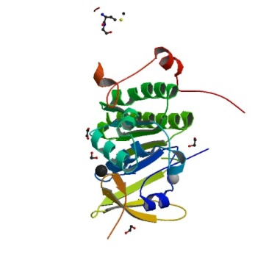
List of terms related to samples
= Macromolecule
A macromolecule is a biological construct
In solution for investigation
A*
B*
= assembly
C*
Description of an assembly containing
multiple macromolecules
Biological assembly
for investigation
A*B*
assembly ‘ABC’
A*C*
ABC
It could be in rare cases more then one assembly the macromolecule belongs to so we should be careful of how to describe
this and or strict with the definition

Slide 5
List of terms related to samples
= Macromolecule: biological construct in solution for investigation
Acronym
Molecular Mass
Number of individual protein chain and residues in each
Number of individual DNA strands and bases in each
Number of individual RNA strands and bases in each
Sequence
assembly (s)
List of regions indicating which part of the assembly(s) the macromolecule is
List of possible structures (PDB)
Which part of the macromolecule the structure is
= assembly: Description of an assembly containing multiple macromolecules
Macromolecule
List of macromolecules

Slide 6
List of terms related to samples
= Buffer: the matched solution in which a sample is suspended
Name/Acronym
Concentration = 0
Temperature
Set Point
Measure for each frame
Type of measurement
Volume to load
pH
Composition
List of additives
= Sample: Specific measurement details for the macromolecule
Macromolecule
Buffer
Concentration > 0
Temperature
Set Point
Measure for each frame
Name: MACROMOLECULE acronym_BUFFER acronym_CONCENTRATION ???
Type of measurement
Volume to load
Comments

Slide 7
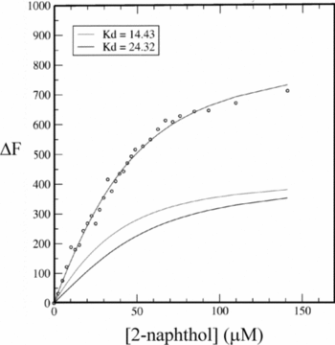
List of terms related to data acquisition
= Frame: One individual exposure of the detector (.edf image and 1D curve .dat)
= Measurement/Run: all frames for an individual acquisition (buffer or sample)
= DataCollection: combination of runs (buffer, sample, buffer)
In rare cases it could be (buffer, n*(buffer OR sample), buffer)
DataCollectionGroup : combined DataCollection for one macromolecule (minimum 3 concentrations). In a collection, by definition all samples are in the same buffer there is only one buffer measurement between samples which is classed as both the buffer_after in the first DC and the buffer_before in the subsequent DC.
DC 1
DC 2
DC 3
DC n
…………………….
Data collection Group for one macromolecule

Slide 8
Use Cases

Slide 9
Case 1: How do the subunits fit together
An enzyme which in its functional form is comprised of 3 individual subunits (A, B and C). The first part of the Experiment ( P1) is to determine how the subunits fit together.
P1 will comprises data collections of:
- A, B and C individually
- The dimeric assemblyes of AB and BC
- The trimeric assembly ABC
Thus the assembly will have 6 individual macromolecules associated with it (A, B, C, AB, BC and ABC). Each with a minimum of 3 samples, all with the same buffer conditions
A*
Samples with different concentrations
B*
C*
……………
B1
where n>=3
A*B*
Buffer
A*C*
A*B*C*

Slide 10
Case 1: How do the subunits fit together
Samples with different concentrations
A
…………..
B1
B1
B
B1
…………..
B1
C
…………..
B1
B1
Buffer 1
AB
B_AB
…………..
B_AB
AC
B1
…………..
B1
ABC
B_ABC
…………..
B_ABC
All buffers for the same assembly should have the same conditions ? By default yes BUT they could change

Slide 11
Case 1: How do the subunits fit together
Data collected with no optimization
A
……..
Data Collection Group for A
B
……..
Data Collection Group for B
C
……..
Data Collection Group for C
Data Collection Array
AB
……..
Data Collection Group for AB
AC
……..
Data Collection Group for AC
ABC
……..
Data Collection Group for ABC

Slide 12
Case 2: How does the enzyme function
P2 will comprises data collections of:
The trimeric assembly ABC (same conditions as for P1)
Plus a data collection for each buffer condition (Ligands and additives required for activity and /or non hydrolysable homologues to isolate the various stages of the reaction).
Thus the macromolecule ABC will have an additional n*3 samples where n is the number of buffer conditions that need to be measured.
A
B
No measurements
Samples
C
AB
AC
ABC
B1
B2
……………
Buffers Conditions c1
Buffers Conditions c2
ABC_B1_10_4C
ABC_B1_30_4C
ABC_B1_50_4C
ABC_B2_10_10C
ABC_B2_30_10C
ABC_B2_50_10C

Slide 13
Case 2: How does the enzyme function
Measurements
A
B
C
AB
AC
Buffer conditions 1
Buffer conditions 2
Buffer conditions 3
ABC
…..

Slide 14
Case 3: Kinetic
Designed to follow the reaction from start to finish (minutes or hours). In principle is one sample and by definition one condition, but the sample could be separate volumes from a large well and buffers could be measured as well
Total Time for measurements
Reacting Sample
Reaction starts
Reaction ends
Frame
Frame
Frame
Frame
Frame
Frame
Frame
Frame
Frame
Frame
Frame
Time between measurements
Time (t)

Slide 15
Case 3: Kinetic
If time between measurements > time for each measurement (buffer) then intersperse buffer measurements between samples.
Total Time for measurements
Reacting Sample
Reaction starts
Reaction ends
Frame
Frame
Frame
Frame
Frame
Frame
Buffer
Buffer
Buffer
Buffer
Buffer
Buffer
Buffer
Time (t)

Slide 16
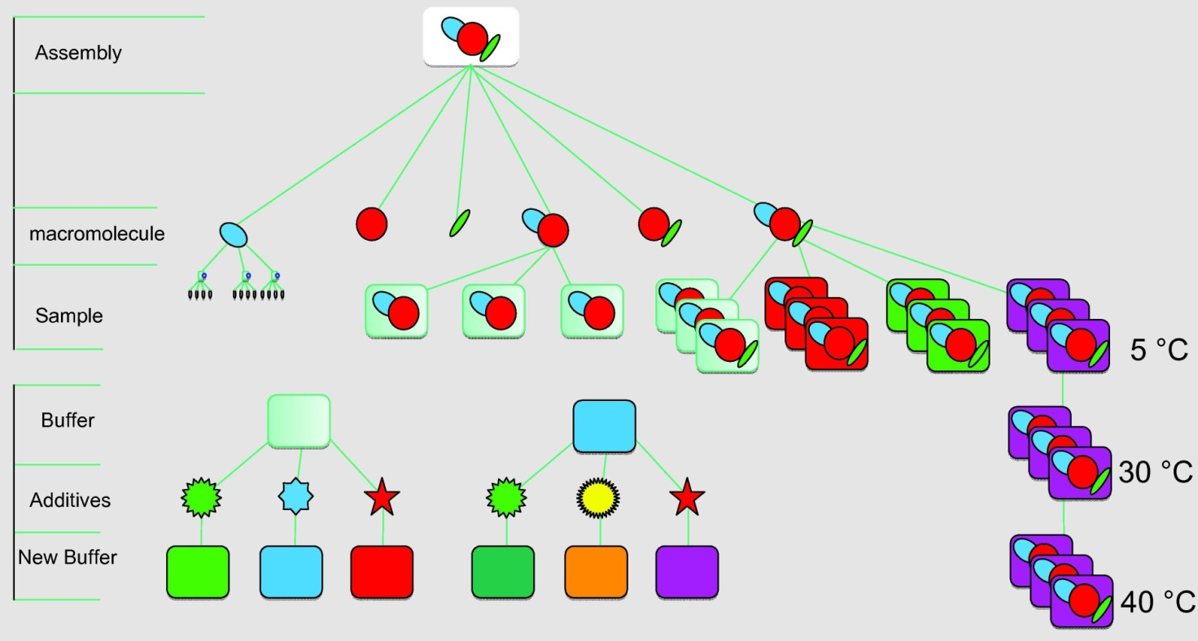

Slide 17
Visual Data Model Draft for Assembly
N
N
1
A assembly has 1..N macromolecules
A macromolecule has 0..N samples
N
1
A sample has 1 buffer associated
………
1
A buffer has 0..N additives
………
Sample: macromolecule + buffer
assembly
macromolecule
Additives

Slide 18
